Slide 1
World Game Trends and Growth (1980 ~ 2016) Except Mobile Game
How had game trends been changed gloablly ?
How had game Sales Growth been Changed in different cultures ?

Slide 2
Questions
How game industries has been changing ?
How had trends of game genres been changed ?
How had game sales growth been changed in different cultures?
Goal
Finding the most popular game genre globally for each 4yr term and future
Finding global sales growth rates of game genre
Finding most popular game genre in different cultures (Japan, Europe, North America, Others)
Finding growth rates of popular genres in different cultures (Japan, Europe, North America, Others)

Slide 3
Understanding of Game industries
Trend lines for game sales (Except mobile game sales)
- Platform game sales had increased until 2009, and then the sales got down from 2010
Cause : Mobile game sales have increased as increasing quality of mobile CPU from 2009 (Smartphone evolution)
Approaching ways for analysis of popular game genre
Trends of changing popular game genre in each cultural and global sales
Cause : Advancing technologies and social cultures changed the popular game genres
This KPI considered the popularity of game genres by proportions of changing game sales

Slide 4
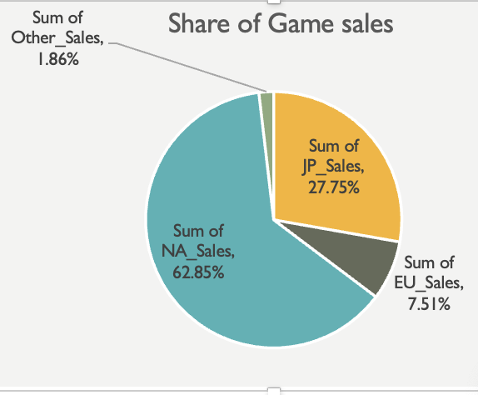
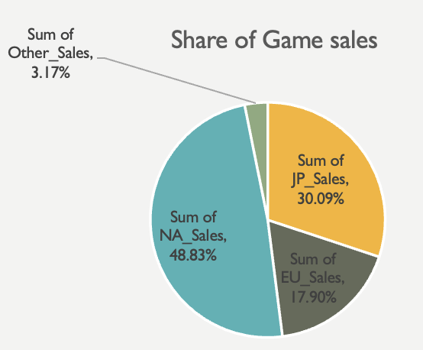
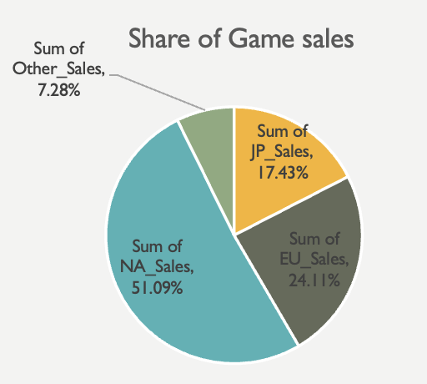
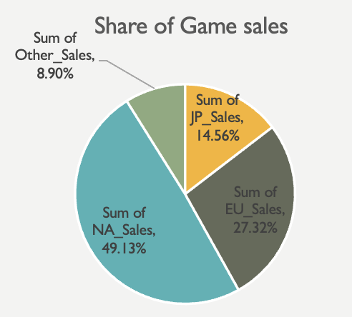
Understanding of Game industries
1988 Sum of Game sales
1998 Sum of Game sales
2007 Sum of Game sales
2016 Sum of Game sales
( NA > JP > EU > OTHER ) => ( NA > EU > JP > OTHER )
Causes of increasing game sales : Increasing number of game users and Active game penetration rates
- Increasing global trades changed the global game sales patterns
Increasing consumers in global game sales : EU, OTHER

Slide 5
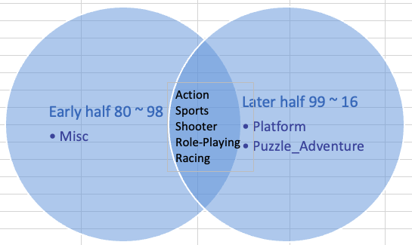
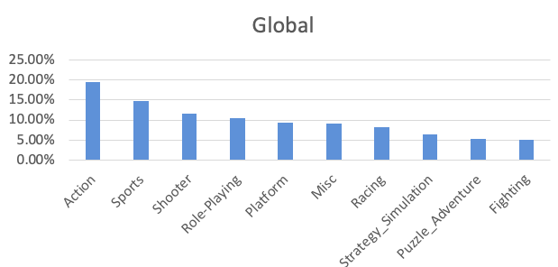
Understanding of Game industries
In 75 percentages of total game sales 1980 ~ 1999 and 1999 ~ 2016 , Action, Sports, Shooter, Role-Playing and Racing are coincidentally occupied
Steady seller in game sales : Action, Sports, Shooter, Role-Playing and Racing
Game genres in upper 75% of total sales : Action, Sports, Shooter, Role_playing, Platform and Misc
Game genres in lower 25% of total sales : Racing, Strategy_Simulation, Puzzle_Adventure, Fighting

Slide 6
Changing Global Game Trends
Trend line road map of game genre in 75~80% sales
global 1980~1986 |  | 1987~1990 |  | 1991~1994 |  | 1995~1998 |  | 1999~2002 |  | 2003~2006 |  | 2007~20010 |  | 2011~2016
Platform | 30.81% | Platform | 38.11% | Platform | 29.32% | Role-Playing | 14.52% | Action | 17.63% | Sports | 17.94% | Action | 19.55% | Action | 28.95%
Shooter | 24.50% | Puzzle_Adventure | 28.00% | Fighting | 14.07% | Sports | 13.06% | Sports | 15.96% | Action | 16.86% | Sports | 16.60% | Shooter | 20.07%
Action | 18.65% | Role-Playing | 8.99% | Puzzle_Adventure | 13.30% | Platform | 12.98% | Role-Playing | 12.32% | Racing | 10.84% | Misc | 13.81% | Role-Playing | 12.25%
Puzzle_Adventure | 8.46% |  |  | Role-Playing | 9.77% | Racing | 12.64% | Racing | 12.14% | Misc | 10.45% | Shooter | 10.86% | Sports | 12.10%
 |  |  |  | Sports | 7.25% | Action | 12.24% | Platform | 10.35% | Role-Playing | 9.70% | Role-Playing | 8.69% | Misc | 7.35%
 |  |  |  | Action | 5.97% | Fighting | 10.25% | Shooter | 7.83% | Platform | 9.30% | Strategy_Simulation | 7.79%
1980
1987
1991
1995
1999
2003
2007
2011
2016
Action
Sports
Platform
Role-Playing
Puzzle_Adventure
Misc
Racing
Fighting
Shooter

Slide 7
Changing Global Game Trends
Used process : multiple linear regr
The most popular game genre trends (Action, Platform, Role_playing and Sports)
Popular genres in 80~1986 (Platform, Action) => 99~2010 (Action, Sports)
In the 75 percentages of game sales, frequencies of the popular genres were at least 6 out of 8 terms
Potentially positive sales after 2016 : Role playing, Action
Potentially negative sales after 2016 : Sports, Platform

Slide 8
Changing Global Game Trends
Used process : multiple linear regr
2nd tier popular game genre trends (Shooter, Racing and Misc)
Popular genres in 80~1986 (Shooter) => 87~2002 (Racing) => 07~2010(Misc)
In the 75 percentages of game sales, frequencies of the the genres were at least 3 out of 8 terms
Potentially positive sales after 2016 : Shooter, Racing
Potentially negative sales after 2016 : Misc
Valuable genres for analysis : Action, Platform, Role_playing, Sports, Shooter, Racing and Misc

Slide 9
Growth rates of game genre -global Sales-
Growth rates rank 1980-1998 : 1 Platform – 2 Racing – 3 Shooter – 4 Action – 5 Sports – 6 Misc – 7 Role-playing
Growth rates rank 1998-2016 : 1 Action – 2 Shooter – 3 Misc – 4 Sports – 5 Racing – 6 Role-Playin – 7 Platform
Genres of increasing sales : Action, Role-Playing, Sports, Misc and Shooter
Steady seller from two terms : Action and Shooter
Reason : Action and Shooter are always in high tier and evaluated positively from this analysis

Slide 10
popular game genre in na
NA game sales each genre (Divided 1980~2016 in 9 years)
Removed genres (except Misc) which are under 10% of average sales between 1980~2016
Genres of high game sales in NA : Action (Avg sales : 20.74%) , Platform (Avg sales : 22.65%), Puzzle_Adventure (Avg sales : 11.05%), Shooter (Avg sales : 16.83%), Sports (Avg sales : 14.28%) and Misc (Avg sales : 7.21%)
Why Misc ? Increasing rate of Misc is constantly high
Positive insights : Action, Sports and Misc are constantly increasing
Negative insights : Platform, Puzzle_Adventure and Sports are decreasing

Slide 11
popular game genre in EU
EU game sales each genre (Divided 1980~2016 in 9 years)
Removed genres which are under 10% of average sales between 1980~2016
Genres of high game sales in EU : Action (Avg sales : 17.88%) , Platform (Avg sales : 18.77%), Shooter (Avg sales : 10.43%) and Sports (Avg sales : 12.67%)
Positive insights : Action and Shooter are increasing
Negative insights : Platform are rapidly decreasing

Slide 12
popular game genre in JP
JP game sales each genre (Divided 1980~2016 in 9 years)
Removed genres which are under 10% of average sales between 1980~2016
Genres of high game sales in JP : Action (Avg sales : 11.15%) , Platform (Avg sales : 14.43%), Role-Playing (Avg sales : 24.33%) and Sport (Avg sales : 11.86%)
Positive insights : Action and Role-Playing are constantly increasing
Negative insights : Platform and Sports are decreasing

Slide 13
popular game genre in Other
JP game sales each genre (Divided 1980~2016 in 9 years)
Removed genres which are under 10% of average sales between 1980~2016
Genres of high game sales in Other : Action (Avg sales : 17.47%) , Platform (Avg sales : 15.06%), Role-Playing (Avg sales : 11.81%), Shooter(Avg sales : 10.5%) and Sport (Avg sales : 12.99%)
Positive insights : Action and Shooter are increasing
Negative insights : Platform and Sports are decreasing

Slide 14
Growth rates of game sales in NA
Positive avg growth rates in term 1~4 (1980~1996) : Misc (12%), Sports (12%)
Positive avg growth rates in term 4~6 (1997~2004) : Action (3%), Misc (10%), Puzzle_adventure (6%), Shooter (5%)
Positive avg growth rates in term 6~8 (2005 ~ 2016) : Action (6%) and Shooter (11%)

Slide 15
Growth rates of game sales in EU
Positive avg growth rates in term 1~4 (1980~1996) : Action (1%), Sports (6%)
Positive avg growth rates in term 4~6 (1997~2004) : Shooter (6%), Sports (3%)
Positive avg growth rates in term 6~8 (2005 ~ 2016) : Action (8%), Shooter (11%)

Slide 16
Growth rates of game sales in JP
Positive avg growth rates in term 1~4 (1980~1996) : Role-playing (8%)
Positive avg growth rates in term 4~6 (1997~2004) : Action (4%), Platform (2%)
Positive avg growth rates in term 6~8 (2005 ~ 2016) : Action (15%), Role-Playing (5%)

Slide 17
Growth rates of game sales in other
Positive avg growth rates in term 1~4 (1980~1996) : Action (3%), Role-Playing (1%), Sports (12%)
Positive avg growth rates in term 4~6 (1997~2004) : Action (4%), Shooter (10%), Sports (2%)
Positive avg growth rates in term 6~8 (2005 ~ 2016) : Action (7%), Role-Playing (4%) Shooter (11%)

Slide 18
Conclusion
Global
The most popular game genre : Action, Platform, Role_playing and Sports
Genres of recent increasing sales : Action and Role-Playing
NA
Recent popular game genres : Action, Sports and Misc
Recent Growing genres : Action and Shooter
EU
Recent popular game genres : Action and Shooter
Recent Growing genres : Action and Shooter
JP
Recent popular game genres : Action and Role-Playing
Recent Growing genres : Action and Role-Playing
OTHER
Recent popular game genres : Action and Shooter
Recent Growing genres : Action, Role-Playing and Shooter
Confidence rank : 1. Action 2. Role-Plating, Shooter 3. Sports

